Slide 1
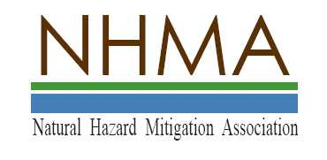
Natural Floodplain Functions Alliance
“Understanding the Arkansas Game and Fish Case and the Importance of that Case to Protecting Floodplains and Wetlands”
December 10, 2012
Edward A. Thomas Esq.
President
Natural Hazard Mitigation Association
This presentation is copyrighted. Permission to use is granted, provided credit is given to Edward A. Thomas Esq., LLC and the Natural Hazard Mitigation Association

Slide 2
Howdy!
I appear today in a pro bono presentation on behalf of:
The Natural Hazard Mitigation Association &
The Natural Floodplain Functions Alliance
This is not and cannot be legal advice; nor does this presentation necessarily represent the views of anyone other than Ed Thomas
This presentation based on general principles of law, and public policy
Notes:
This presentation Is Not-Anti Development
It is Pro-Good, Thoughtful Development Which Does Not Harm People and Property

Slide 3
First Some Words From Our Sponsor
What is NHMA?
NHMA was created in 2008
to bring together the various
individuals and organizations
working in the field of
Climate Adaptation &
Hazard mitigation.

Slide 4
The Case
Arkansas Game & Fish Commission v. United States, No. 11-597 (Dec. 4, 2012)
Unanimous decision by the US Supreme Court
Incredibly important to Floodplain Managers, Wetland Managers and anyone who cares about Hazard Mitigation
Why is it important?
What does it mean?

Slide 5
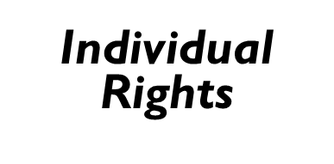
Fundamental Law Involved: The Constitution of the United States

Slide 6
The Constitution of the United States
Fifth Amendment to the Constitution: “… nor shall private property be taken for public use without just compensation.”
Was this Some Theoretical Thought, or Passing Fancy?
Normally my lectures and writing focus on "regulatory takings"
Pennsylvania Coal Company vs. Mahon 260 US 293 (1922). But See: Keystone Coal 480 US 470, 1987.
6
Notes:
6
Lets start with the US Constitution.
PA Coal was a bit strange- Haddacheck v Sebastian-Habeas Corpus etc 87% loss; Mugar v. KS total loss; Keystone Coal seems to overturn Pennsylvania Coal without ever saying so.

Slide 7
Arkansas Game and Fish
Not a “regulatory takings” case
This case is about direct damage or intrusion to a property by government action

Slide 8
The Facts of the Case
Arkansas is suing the US Army Corps of Engineers alleging damage to Dave Donaldson Black River Wildlife Management Area (WMA), located along the Black River
WMA covers about 24,000 acres in Clay, Randolph and Greene Counties, Arkansas
The majority of the area was purchased to preserve bottomland habitat and provide top-quality waterfowl hunting.
The Donaldson WMA represents a significant portion of the remaining bottomland hardwood habitat in eastern Arkansas and provides critical wintering habitat to thousands of migratory birds.

Slide 9
Dave Donaldson Black River Wildlife Management Area (WMA)
Dave Donaldson WMA is a “Crown Jewel” of our state’s great wildlife management heritage….”
Arkansas Game & Fish Commission Chief Legal Counsel Jim Goodhart
Photo from the Arkansas Game and Fish Commission

Slide 10
The Area Has Extensive Wetlands
Wetlands
Wetlands
Wetlands

Slide 11
Management of the Donaldson WMA
Seasonal flooding of about 7,000 acres of green timber to attract waterfowl is done yearly
Selective thinning of trees is done to stimulate the growth of new timber, to provide a diverse habitat type and to remove unhealthy or unproductive trees from the forest
Photograph of a flooded forest courtesy of Chris Violette in August 2012 Water Log
Notes:
This is not a nature preserve!
It floods
It needs to flood!

Slide 12
US Army Corps of Engineers Involvement
Corps of Engineers built and operates the Clearwater Dam in Missouri about 120 miles away from the Donaldson WMA
Constructed in 1948 for floodcontrol
Operating Plan developed in 1953-lays out the release rates from the dam, but provides for allowable deviations
From 1993-2000 the USACE approved a series of temporary deviations from the 1953 plan in order to provide Missouri farmers more time to harvest their crops
State of Arkansas Game and Fish honks loudly and often, claiming possible damage to Donaldson WMA

Slide 13
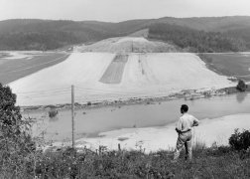
“One of the largest single events that took place in the history of Piedmont…was the official opening of the Clearwater Lake Dam”
Although Clearwater Lake's original purpose was allotted for flood control, today it has become one of the largest tourist attractions through out Southeast Missouri
Little Rock Corps of Engineers estimate that over a million people per year travel to Clearwater to enjoy camping, canoeing, boating, fishing, swimming and just plain relaxing
Notes:
This dam and the water it impounds is a big deal locally!!

Slide 14
So We Have a Classic Property Rights Dispute
Missouri Farmers want more time to harvest crops and make money
Maybe Missouri tourism and other money making is playing a role too
Arkansas Game and Fish wants to protect the beauty, value & profitable operations of its “Crown Jewel” in Arkansas

Slide 15
USACE Must Balance Rights Of Competing Parties
Missouri Farmers &
Tourism
Arkansas State Agency and Crown Jewel
Donaldson Wildlife Management Area

Slide 16
Negotiations About The Issue
USACE forms an Advisory Committee, which includes Arkansas Game and Fish, and attempts to develop formal revisions to the 1953 plan for releasing water from the Clearwater during the period 1993-2000
A 1999 USACE NEPA Environmental Study finds there is potential damage due the 1993 and then ongoing water releases; so in 2000 USACE reverts to 1953 plan of releases
Arkansas wants compensation for damages to the Donaldson WMA hardwood forests caused by longer duration of flooding, during critical months of the growing season, caused by the deviations from the 1953 plan, during the period 1993-2000

Slide 17
In 2005 Litigation Begins
Negotiations for damage to forest and land restoration were not successful
Since this case involves moving water into someone's property, normally it would be considered some sort of Tort Case involving a trespass or a similar action
Instead the State of Arkansas makes this into a lawsuit based on the protections of the United States Constitution’s Fifth Amendment
Why?

Slide 18
Special Sovereign Immunity For The United States!
“No liability of any kind shall attach to or rest upon the United States for any damage from or by floods or flood waters at any place….” United States Code TITLE 33 — NAVIGATION AND NAVIGABLE WATERS CHAPTER 15 — FLOOD CONTROL 33 U.S.C. § 702c.
Courts Have Found That This Phrase Applies to Flood Control But Not to Other Efforts Such as Navigation(See, GRACI v. UNITED STATES, 456 F.2d 20 (5th Cir. 1971)).
Litigation Pending to Test Constitutional Limits of this Immunity is continuing; the Graci Case holding is very much in question

Slide 19
We Have long Recognized That There Are Two Major Impediments to Safe Regulation
NOAA recently completed a study which surveyed planners as to impediments to safe development
Two major reasons cited:
Fear of the “taking” issue
Economic pressure

Slide 20
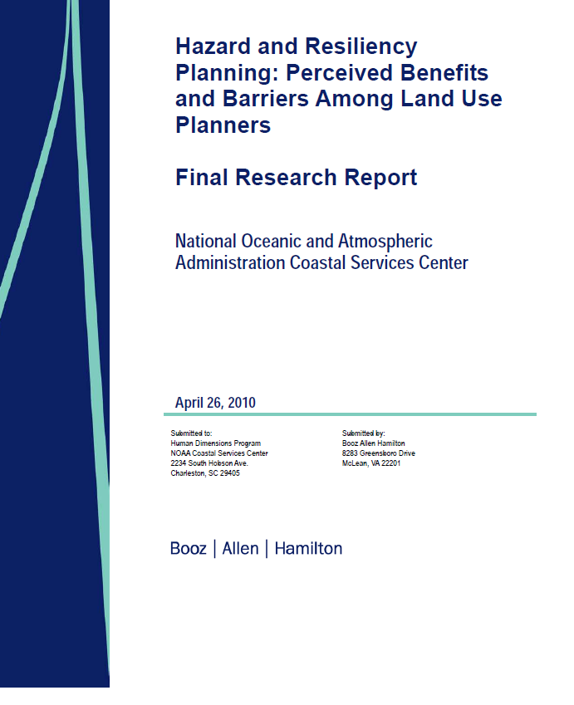

Slide 21
We Need To Also Recognize A Third Major Impediment To Safe Development: A Perception of Immunity
Some public officials believe that they are immune from suit for the consequences of actions they take which harms others
Many Floodplain Managers have told me that such an attitude is making their jobs much more difficult
This topic was covered at some length in a FEMA funded Workshop put on by the Arkansas Association of Floodplain Managers through the Association of State Floodplain Managers
PowerPoints and a CD of the Workshop will soon be available on the Arkansas Floodplain Managers and the NHMA websites

Slide 22
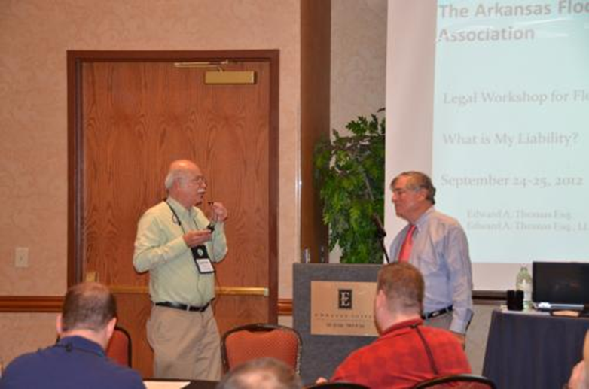
The Arkansas Floodplain Management Association
Legal Workshop for Floodplain Management
What is My Liability?
September 24-25, 2012
Edward A. Thomas Esq.
Edward A. Thomas Esq., LLC

Slide 23
Arkansas Fish and Game v. US Litigation
At Trial Arkansas wins $5.5 million for damages, and $176,000 for remediation following an 11 day trial in the US Court of Claims, which finds the flooding was substantial and predictable
On Appeal, US wins! The US Court of Appeals buys the very clever and carefully crafted US government argument that since the flooding was temporary it could not be a taking

Slide 24
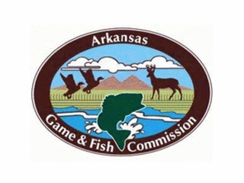
Then, After US Wins First Appeal It Offers to Settle Case
State wants damages for value of dead and dying timber and funding to restore areas where timber died on Donaldson WMA; especially wants the USACE to change the river flow operations so as to prevent future damage to the timber
US offered to settle for $ $13 Million
Will not agree, however, to State request to make a legally binding to return river flow operations to 1953 Plan

Slide 25
US Supreme Court Rules
Just because the flooding was temporary it might still be a “Taking”
Very clever government argument that temporary flooding cannot be a taking is based on dicta in an old case, which seemed to indicate that to be a “Taking” flooding must be permanent. [Sanguinetti v. United States, 264 U.S. 146 (1924)]
“We rule today, simply and only, that government induced flooding temporary in duration gains no automatic exemption from Takings Clause inspection.

Slide 26
Please Note That Litigation for Claimed Harm Is Easier Now Than In Times Past
Forensic hydrologists
Forensic hydraulic engineers
Forensic Wildfire, and other Experts
26
Notes:
26
Today, sophisticated modeling techniques facilitate proof of causation and allocation of fault although proof may still be difficult. See, e.g., Lea Company v. North Carolina Board of Transportation, 304 S.E.2d 164 (N.C., 1983)

Slide 27
Now What?
This case goes back to the lower courts for further proceedings relative to, among other items:
Causation
Foreseeability
Amount of damages-if any

Slide 28
Court Tests for Future Takings Litigation
The Lingle test for a “Taking” described in the writings and lectures of Dr. Jon Kusler, Sam Riley Medlock and me is still in effect for evaluating a “Taking”
We may have an additional factor to add to Lingle:
“degree to which the invasion is intended or is a foreseeable result”

Slide 29
So What? Why Is This Case Important?
The case strongly affirms the protection of property rights
So much of the legal underpinning of floodplain management, hazard mitigation and wetlands protection is based on concepts of protecting the property and rights of our individuals, communities and the Nation
Our friends in the Property Rights Movement are delighted too

Slide 30
So What? Why Else Is This Case Important?
If the Supreme Court had held that a temporary invasion of property could not, as a matter of Law, be a an unconstitutional deprivation of property contrary to the 5th Amendment to the US Constitution:
Then, at least some of our existing case law & legal writings which indicate that nobody has the right to use their property in such a manner as to cause damage to others would need to be reexamined so as to distinguish those situations from this very unusual situation

Slide 31
In Conclusion
Fundamentally our society must and will choose either:
Better standards to protect the economy, the environment, the taxpayer, people & property
or
Current practices which inevitably will result in destruction and litigation
The Arkansas Game and Fish Case does not hurt but rather supports our efforts to build a safer, more sustainable Nation and World

Slide 32
Contact Information:
Natural Hazard Mitigation Association
P.O. Box 55352
Metairie, Louisiana 70055
504-914-6648
www.nhma.info
nathazma@gmail.com
Edward A. Thomas Esq., LLC
edwathomas@aol.com

Slide 33
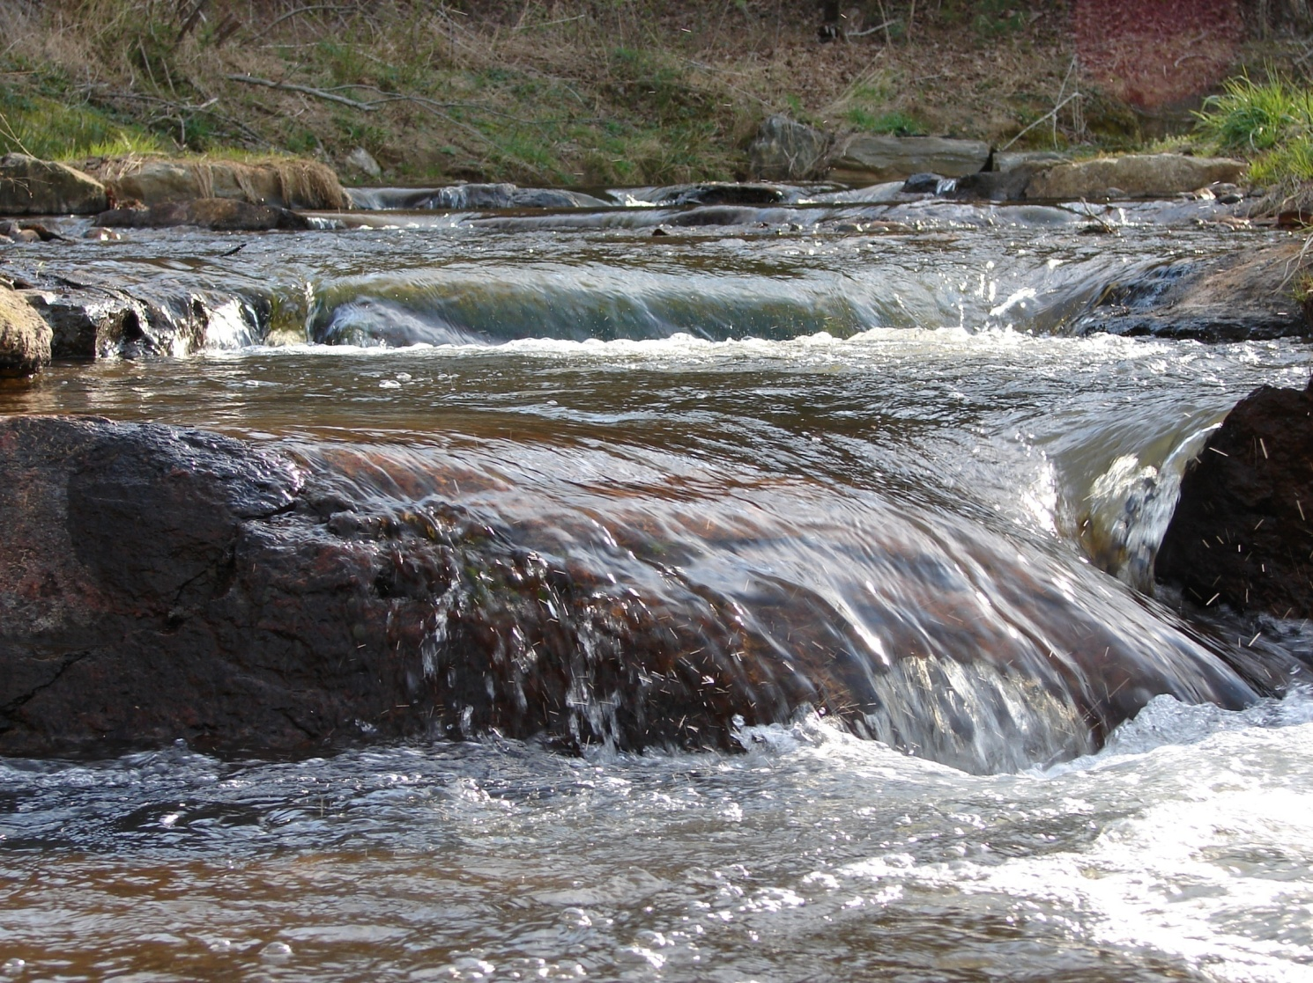
Questions
Comments?

