Slide 1
Women Building Resilience to Disaster in the US: New Resources and Strategies
EMForum Webinar, April 25 2012
E. Enarson, Ph.D.
Independent Scholar, Lyons CO
enarsone@gmail.com

Slide 2
Overview
New scholarship
Looking back—achievements and gaps
Looking ahead—potential action projects
Polling questions and your ideas
Q & A

Slide 3
A growing field--new scholarship
US/Canada
New book coming soon on masculinity in disasters based on firefighters in British Columbia (Shelly Pachalok)
New book coming soon on The Women of the Storm (Emmanuel David)
More to come, I’m very sure!
International
Women, Gender and Disaster: Global Issues and Initiatives (with chapters from the US and Canada, too), Enarson and Chakrabarti, eds. (Sage, 2009)
Women’s Encounter With Disaster, Dasgupta et al., 2010 (from the 3rd USAID funded conference on G&D in Turkey)
More to come, I’m very sure!

Slide 4
The Women of Katrina: How Gender, Race and Class Matter in an American Disaster
David and Enarson, eds., 2012
Vanderbilt University Press
272 pages, 7 x 10 inches
Cloth $69.95s 978-0-8265-1798-2
Paper $34.95s 978-0-8265-1799-9
www.vanderbiltuniversitypress.com
800-627-7377

Slide 5
The Women of Katrina
Foreword
Preface
Introduction—literature review
In Protest
Women on the Front Lines-Testimonials
In Deep Water: Displacement, Loss, & Care
Against the Tide: Resisting, Reclaiming, & Reimagining
Gender in Disaster Theory, Practice, & Research

Slide 6
Women Confronting Natural Disaster: From Vulnerability to Resilience
E. Enarson
Lynne Rienner Press,
February 2012/ca. 250 pages
LC: 2011034702
ISBN: 978-1-58826-831-0
Hard cover, $35
www.rienner.com
303-444-6684 • Fax: 303-444-0824

Slide 7
Table of Contents
Preface
Women and disasters in the US
Representations of women in disasters
How gender changes disaster studies
Measuring vulnerability and capacity
Health and well-being
Violence against women
Intimacy and family life
Houses and homes
Work and workplaces
Grassroots groups and recovery
Building disaster resilience
Fighting for the future
Appendix: A guide to
resources
Next, a quick walk-through

Slide 8
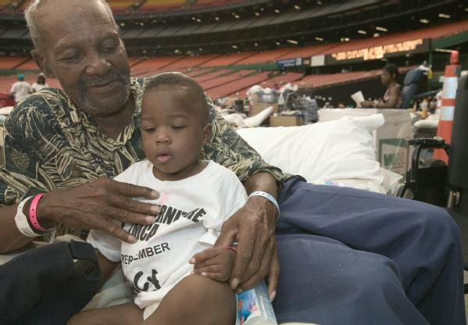
Preface
Why write a book?
Why this way?
Focus on the US
Highlight women
“Natural” disaster?
Resilience?

Slide 9
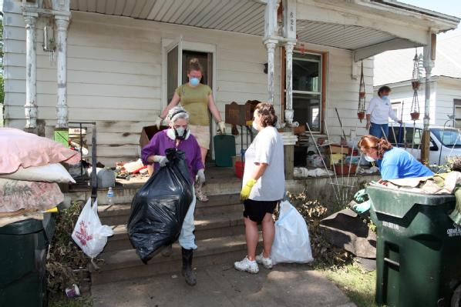
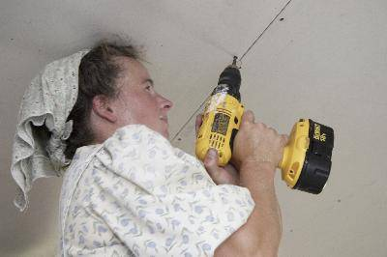
1. Women and disasters in the US
Contextualizing the book
Guide to the reader
And many people to thank!

Slide 10
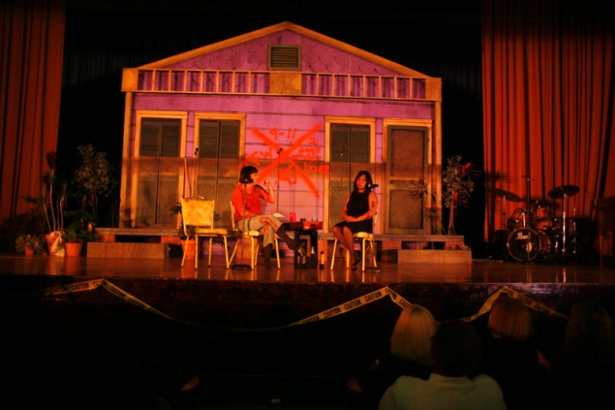
2. Representations of women in disasters
Disaster popular cultures
Gender & disaster in pop culture
Retelling the story—women
Quilts, of course!

Slide 11
Why it matters
Reaching the public
Reframing the issues
Story telling and knowledge exchange
Needed!
More work on new social media from a gender perspective
More work on how women & men respectively use social media in disaster-relevant ways

Slide 12
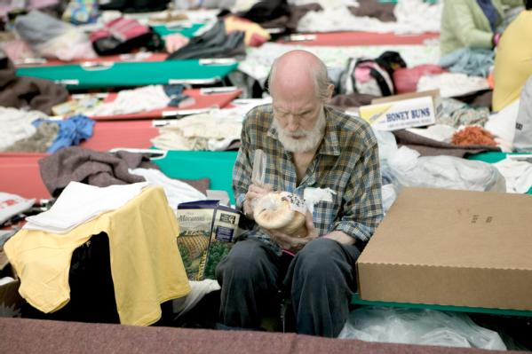
3. How gender changes disaster studies
Theory matters—”finding and framing”
Sociologies of gender and sociologies of disaster
Using feminist theories
Liberal, socialist, radical, multiracial, gender and development, postmodern, feminist political ecology

Slide 13
Why it matters
Reframing the issues
Predictive/explanatory
Priorities for action
Needed!
Theoretical integration of women, gender and disaster analysis with political ecology including climate
Focus on sustainability, social justice, ecosystems
More synthesis with theoretical work in allied fields
More integration with masculinity theories

Slide 14
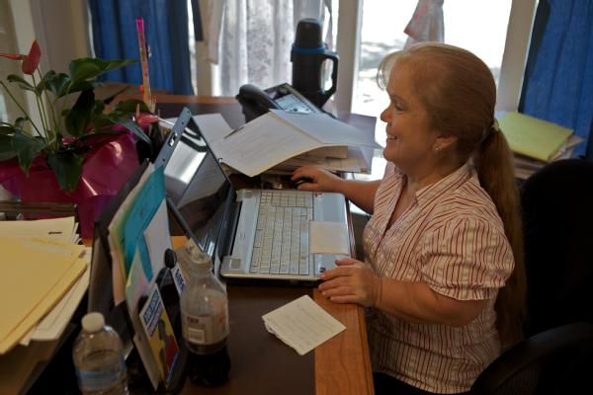
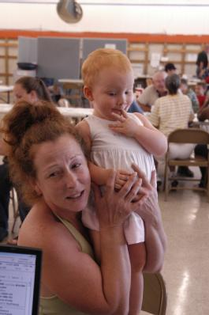
4. Measuring vulnerability and capacity
Gendered vulnerabilities
Wrong turns and blinders
Mapping—cautionary notes
Census data options
Relationships, not numbers

Slide 15
Why it matters
Unanticipated effects & responses
Risk mapping must engage communities
Risk mapping must engage women who live at increased risk, needs and capabilities
Needed!
Sex-specific data in all gov’t supported research
Development and testing of sex/gender indicators including those sensitive to men and boys
Critical analysis of existing mapping tools

Slide 16
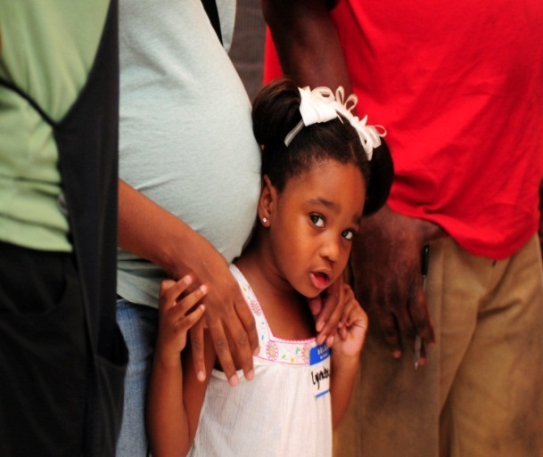
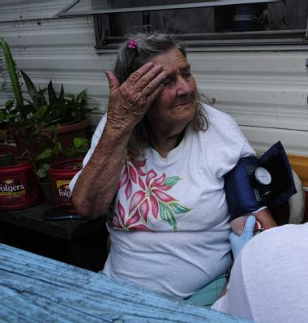
5. Health and well-being
Gender and survival
Reproductive health
Maternal and infant health
Explaining gender patterns in post-disaster mental health

Slide 17
Why it matters
Life & safety
Disrupted services with lasting effects
Inadequate psychosocial responses
Needed!
Critical review and revision of public health in disasters approaches and training guides
Capacity building in women’s health services
Pre-planning to ‘care for the caregivers’
Research: increased attention to men’s reproductive, mental and physical health (non-responders as well as responders)

Slide 18
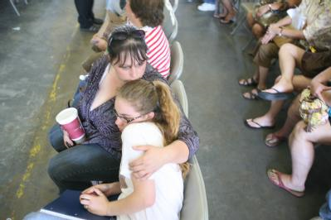
6. Violence against women
Gender-based violence post-disaster data
patterns and gaps
US case studies
from Exxon Valdez to Katrina/Rita
Alternate explanations

Slide 19
Why it matters
Public health & safety; children’s well-being
Fear undermines resilience
Relates to shelter protocol and training, psychosocial intervention, community partnerships and outreach
Needed!
Community-wide planning for possible increases
Systematic data collection for analysis and planning
Capacity building in antiviolence community organizations
Policy directives on gender based violence in US disasters
Research: other forms of family violence; men and violence; GLBTQ experiences; “good practice” evaluations

Slide 20
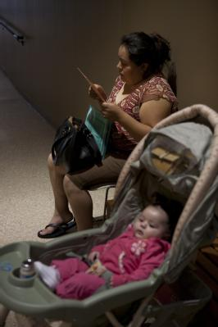
7. Intimacy & family life
Divisions and strains
Expanding burdens—domestic labor, care work, emotion work
Disaster mothering

Slide 21
Why it matters
Gender blind approaches don’t support real families
Central role of mothers/single mothers
Diversity & change in households highly visible ‘through women’s eyes’
Needed!
Child care; capacity building in child care orgs
Family friendly/women friendly policy and practice in all aspects of DRR
Planned support systems for families in crisis, with sensitivity to gender/women’s issues
Research on disaster fathering and single parenting

Slide 22
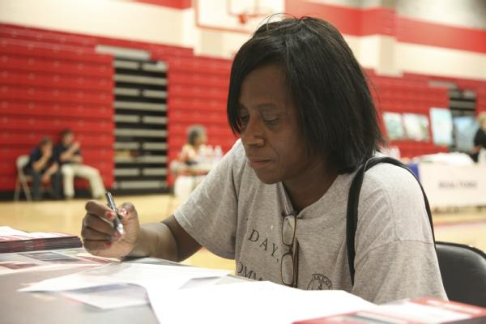
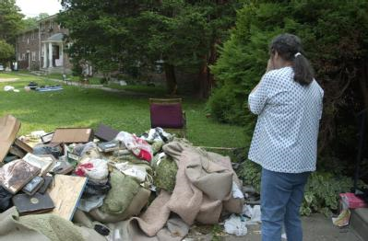
8. Housing and homes
Women’s pre-event
housing insecurity
Gendered risk
communication
Gender in evacuation
Shelter experiences
Roadblocks to resettlement

Slide 23
Why it matters
Prioritizing women as risk communicators
Housing and long-term recovery
Women’ s safety in shelters/temporary accommodation
Relates to shelter design and management
Needed!
Gendered risk communication, e.g. men & evacuation
Supporting women in construction
Partnerships with women’s housing specialists
Research: gender & rehousing/sheltering/homelessness

Slide 24
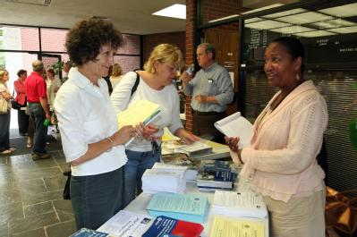
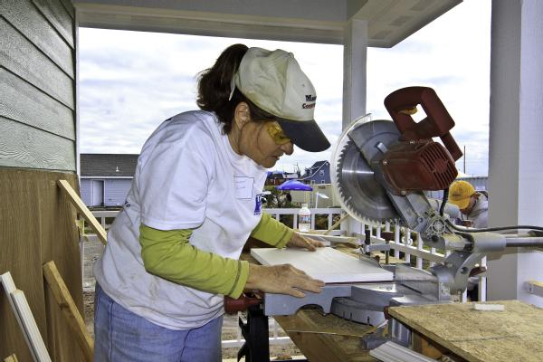
9. Work and workplaces
Impacts on women’s employment, home-based work, resource-based incomes
Barriers to women’s economic recovery
Women’s off- stage disaster occupations

Slide 25
Why it matters
Women’s income essential to full recovery
Well-prepared/responsive women’s workplaces an essential for resilience
Return to work enables community recovery
Needed!
Include informal employment and family work (his and hers) in economic recovery plans
Research: full accounting of direct/indirect economic effects, including on home-based work
Capacity building in women’s businesses and unions
Plan for safe, affordable, diverse child/family care

Slide 26
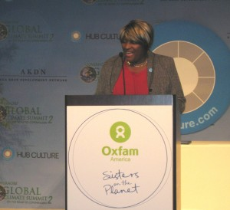
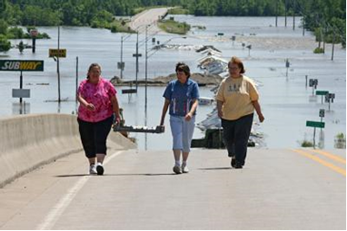
10. Grassroots groups and recovery
Shift in focus with Ch l0
Volunteering
Women’s collective work
Emergent organizations
Sources of difference
Research questions

Slide 27
Why it matters
Women’s leadership essential to DRR
Recovery planning must support women’s grassroots initiatives
Barriers to women’s full participation undermine long-term recovery
Needed!
Knowledge exchange among disaster-affected women
Capacity building in women’s/men’s orgs (all kinds)
Research: sustainability of women’s disaster work; disaster response work by men’s organizations; gender dimensions of decision making and control in rebuilding

Slide 28
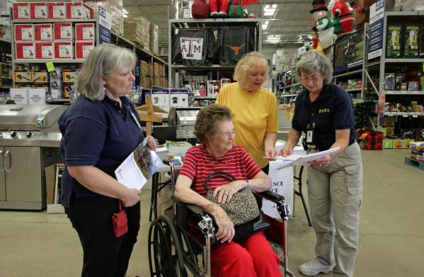
11. Building disaster resilience
Gender mainstreaming
women responders & women in EM
barriers, reflections
Challenging male power
Gender & HFA/USA
Change potential in women’s movements
Three lines of action

Slide 29
Why it matters
DRR = “Whole” (& equitable) community approach
Gender inequalities undermine resilience
Untapped potential in women’s movements
Climate change (women?) will drive the agenda
Needed!
Building on women’s and men’s organizational strengths
Risk reducing partnerships with women’s groups
Outreach to gender and climate change community
Research: evaluating “promising practice”; lessons from the global South for the North

Slide 30
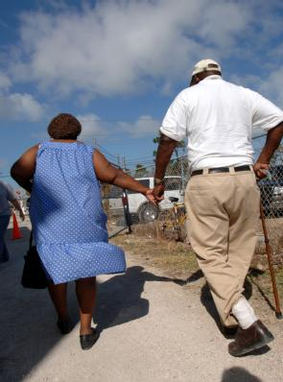
12. Fighting for the future
“The future may challenge us in ways difficult to imagine. But we have been here before and risen to the occasion—and we can do it again. There is a future worth fighting fore, women and men together. May it come soon.”
Enarson, 2012, p. 198

Slide 31
Looking back: some achievements
Awareness increasing
academic talks and research
community dialogue (?)
increasing policy attention (?), e.g. March 8, 2012 Women and Youth Emergency Management Stakeholder Update
Women in emergency management organizing
EMPOWER; inWEM
College teaching resources expanding, e.g.
Occasional G&D courses taught for EM
Gender chapters in EM textbooks

Slide 32
Increasing salience, e.g. The Gender and Disaster Resilience Alliance with ideas for action, education, and training, publications and video clips, networking and a listserv
Flash--The GDRA is partnering with EPI Global (Emergency Preparedness Initiative Global) to present a 5-part webinar series: see www.usgdra.org or www.epiglobal.org

Slide 33
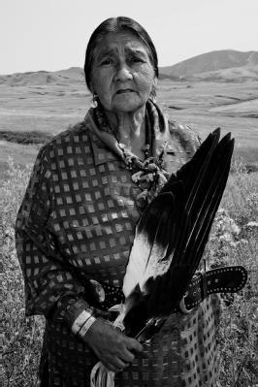
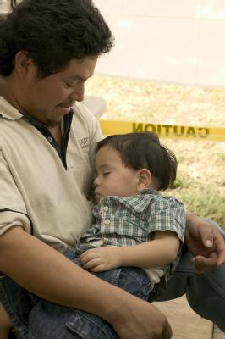
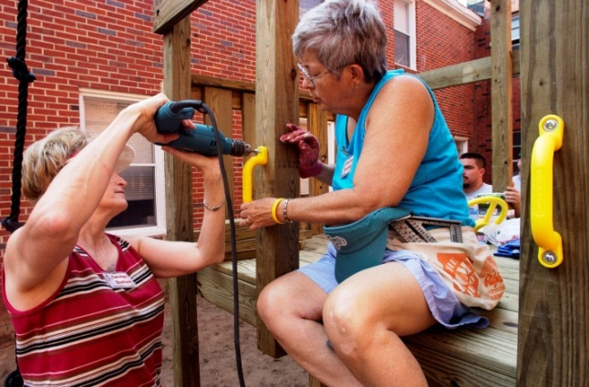
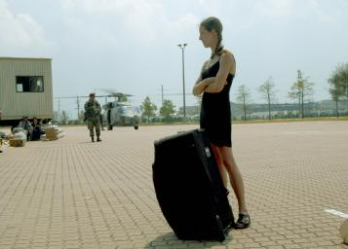
Looking back: some persistent knowledge gaps
About boys and men
About marginalized women
About girls
About effective change

Slide 34
Looking back: some persistent policy/practice gaps
Gender poorly reflected in DRR policy frameworks, e.g. Whole Community approach, SFI, Recovery framework
Gender concerns of women and men not well integrated into emergency planning documents, activities, and social processes
Gender competency not “core” in EM professional preparation

Slide 35
Looking ahead: 10 practical actions
Grassroots women assessing risk
Risk assessment template for local women has been developed; needs revision for use in the US; needs promotion, demonstration, and evaluation
Reducing gender violence in the
aftermath: Promising practice
Comparative action research in the US, CA, NZ, and AU to identify and test promising practices preventing and responding to sexual assault and DV.

Slide 36
Reaching men to reduce risk: Gender-
focused communication strategies
Demonstration project to assess potential for social marketing utilizing new and/or traditional media. Targets men across the lifespan and in diverse communities with emphasis on preparedness, mitigation, evacuation.
Girls, boys and household risk reduction
Child-centered, gender-sensitive educational campaign based on global models utilizing a wide range of media and building on single-sex org’s.

Slide 37
Women Building Disaster Resilience Campaign
Peer learning teams make site visits to high-risk locales meeting with emergency managers and with women’s groups for knowledge exchange, network and capacity building. Communication via women’s and men’s mass media outlets, new social media.
Putting Disaster on Women’s Agenda
National roundtable of women’s organizations called to strategize about how best to relate DRR to existing gender initiatives and identify new synergies, including with men’s progressive org’s.

Slide 38
Knowledge exchange: Gender, disaster,
climate
Multidisciplinary annotated bibliography on gender, disaster, and climate change in the US with creative follow-up dissemination and dialogue campaign. Bringing disaster expertise to climate work and incorporating global expertise of women and men on gender dimensions of climate uncertainty.
Gender training for disaster responders: An interactive training module
Short, user-friendly resource for CEM programs demonstrating intersectional approach to gender analysis in DRR.

Slide 39
Concept note: Gender as a cross-cutting theme in reducing risk in the US
Policy document with specific recommendations for mainstreaming gender concerns holistically in DRR and disaster management, drawing on successful strategies from other communities in the US and from international models.
Networking with women’s and men’s groups in high-risk neighborhoods.
Capacity building template for use in diverse communities with emphasis on engaging single-sex organizations, groups, and networks to increase awareness and response capacity. Women and men working together & separately.

Slide 40
Many ways forward
Building the GDRA
Sister network to the global GDN
Web space on the GDN website
Other significant connections, including with emerging GDN-CA and GDN-LAC (to include Mexico)
Two-year organizational development campaign needed enabling, e.g.
enhanced outreach and service, e.g. through website development, outreach materials, membership development and support, internships, speakers’ bureaus, mentoring, knowledge exchange, project partnerships
incorporation? funding? logistics? Leadership?

Slide 41
Potential partnerships, e.g. with
Women’s groups and campaigns
Environmental/climate networks
Other relevant community/grassroots networks
National and local women’s & men’s organizations American Red Cross and other lead NGO relief and recovery orgs active in the US
Tribal emergency planning units
Health agencies, e.g. Office of Women’s Health
Health and human service women’s agencies
Gender and disaster networks in other HDCs
And a host of other DRR networks and organizations active in the US but not reflecting the gender dimensions of disaster risk and the practice of emergency management

Slide 42
Potential teaching/training activities, e.g.
Develop college curricula (Higher Education Project and others)
Develop CERT materials and related training modules
Develop pre/post conference workshops for IAEM and other relevant meetings for states/regions
Initiate community presentations/dialogues
Mass communications, e.g. articles for women’s and men’s magazines, blogging

Slide 43
Potential policy development, e.g. relating to the 5 priorities of the Hyogo Framework for Action (HFA)
Ensure that disaster risk reduction is a national and a local priority with a strong institutional basis for implementation.
Identify, assess and monitor disaster risks and enhance early warning.
Use knowledge, innovation and education to build a culture of safety and resilience at all levels.
Reduce the underlying risk factors.
Strengthen disaster preparedness for effective response at all levels.

Slide 44
Potential policy development, e.g. relating to FEMA’s Whole Community approach
Understand community complexity.
Recognize community capabilities and needs.
Foster relationships with community leaders.
Build and maintain partnerships.
Empower local action.
Leverage and strengthen social infrastructure, networks, and assets.
And consider the space for gender in the Strategic Foresight Initiative.

Slide 45
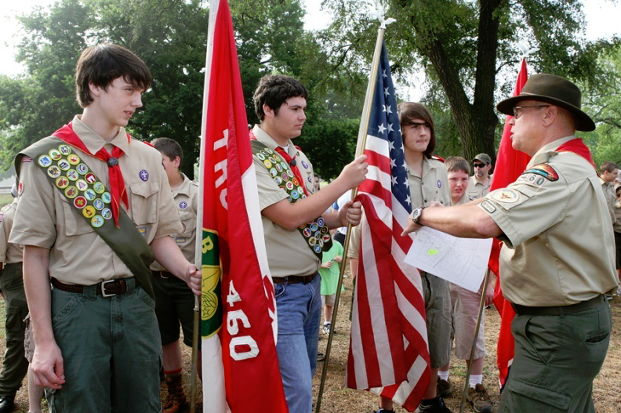
A simple example: girls, too?
Boys were profiled in FEMA’s 2011 Whole Community Approach publication (p. 4) but not this new partnership between Girls Scouts USA and EMPOWER. Both or neither?
Figure 2: Madison, Tennessee, May 29, 2010—Gary Lima, Tennessee Emergency Management Agency Community Relations Coordinator, leads Boy Scout troop #460 in a Memorial Day project to place flags on graves. The picture reflects emergency managers becoming involved in the day-to-day activities of community groups. David Fine/FEMA
Secretary Napolitano and Girl Scouts of the USA CEO Kathy Cloninger unveiled the patch and announced a new affiliation between DHS Citizen Corps and the Girl Scouts to advance community preparedness nationwide.
Girl Scout Troop 5127 took the patch program further and not only earned their Emergency Preparedness patch, but also their Bronze Award. The girls created the slogan, "Don't Be Scared, Be Prepared", and produced and starred in their own public service announcement with the help of EMPOWER, an emergency management organization for women. The Girl Scouts were able to professionally record their PSA for television, radio and online distribution channels. http://youtu.be/TEwwAJR_ilo

Slide 46
For discussion. . .
Who are the champions of change?
What resources can be secured?
Are men interested?
Are women? Which women?
Is climate change the driver of change?
And just for fun, how about a few polling questions? Please jot down your thoughts and of course email more complex answers or ideas. I would love to carry on this conversation.

Slide 47
Quick poll [1]
1. In your view, what accounts for these gaps in research, policy, and practice? (select all that apply)
Little knowledge about sex/gender as risk factors
Little knowledge/minimizing of everyday living conditions facing many US women
Equating “gender” with women only
Equating gender & disaster issues with poor countries
Interpreting “gender issues” as “vulnerability” solely
Equating the presence of women with gender sensitive practice, e.g. in emergency management roles
All of the above
Nope, other factors (please chime in)

Slide 48
Quick poll [2]
2. What are the best drivers of change toward more gender-responsive EM practice in the US? (select all that apply)
Advocacy from grassroots women
Advocacy from women/men in emergency management
On-line for-credit training modules/coursework for EM
Public awareness campaigns
Capacity building in women’s organizations
Policy review and recommended changes
All of the above
Nope, other factors (please chime in)

Slide 49
Quick poll [3]
3. Who are potential champions of this work? (select all that apply)
Governmental emergency management orgs
Relief organizations, e.g. Red Cross, faith-based
Business leaders, e.g. in insurance sectpr
Women/men in emergency management roles
Women/men working on climate/environmental issues
Women/men in social justice/women’s rights org’s
Disaster-affected women
All of the above
Nope, other factors (please chime in)

Slide 50
Quick poll [4]
4. What should be the primary focus of collective efforts in US to increase gender sensitivity in DRR? (select all that apply)
Coalition building/community organizing
Develop and disseminate practical resources
Seek partnerships/networking
Mentoring/teaching
Demonstration projects
Advocacy
Build the GDRA
All of the above
Nope, others (please chime in)

Slide 51
Your thoughts? Polling discussion

Slide 52
Resources posted to EMForum
Flyers
Gender and Disaster Network [GDN]
US Gender and Disaster Resilience [GDRA]
Book ordering forms with discounts
The Women of Katrina
Women Confronting Natural disaster
Resource sheet (US)
Please visit the website of the GDRA (thanking fabulous web volunteer Jennifer Tobin-Gurley!), check out the resources, join the listserv, send along your ideas: http://www.usgdra.org

Slide 53
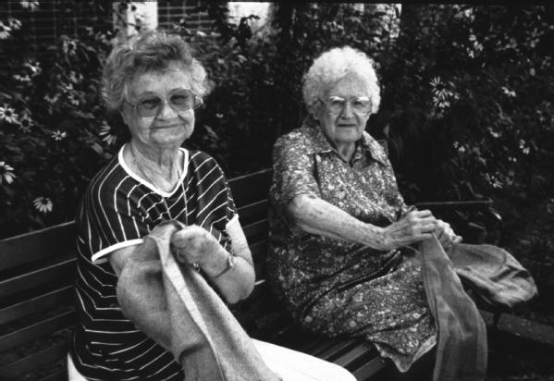
Thanks for tuning in!
Grafton, Ill., July 01, 1993 -- Volunteers of all ages helped with the flood relief. Here, seniors help fill sandbags. Photo by: Liz Roll/FEMA News Photo

