Slide 1
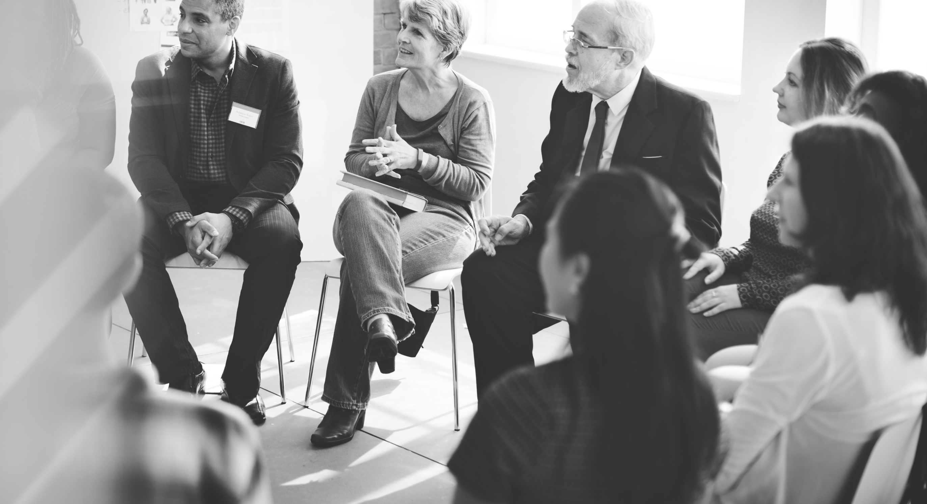
Fostering Dialogue to Support Community Resilience
Resilience Road Marker (#1): Ideas for Implementation from Research and Practice

Slide 2
What is resilience?
Resilience captures that positive sense of persisting and thriving in the face of adversity and unknowns.
Resilience offers the potential of a unified approach to addressing environmental and social vulnerabilities as communities prepare for the impacts of climate change.

Slide 3
Navigating the discourse
SYSTEM
PROPERTY:
OUTCOME:
PROCESS:
“We need a strategy that coordinates every department’s actions to make the city more resilient to a storm.”
Anticipating and responding to shocks and longer-term stresses and changes.
“We need resilient buildings and infrastructure that can withstand extreme weather conditions and flooding, or can easily be repaired if they get damaged.”
Maintaining a key system function.
“We need to have all the voices of our community at the table to address a diversity of threats facing local environments, housing and equity to create a resilient future for us all.”
Maintaining or improving a situation.

Slide 4
Improving the resilience dialogue
Explore Your Own Thinking
Acknowledge Differences & Complementarities
Find Shared Values & Goals
Build Partnerships & Continue the Dialogue

Slide 5
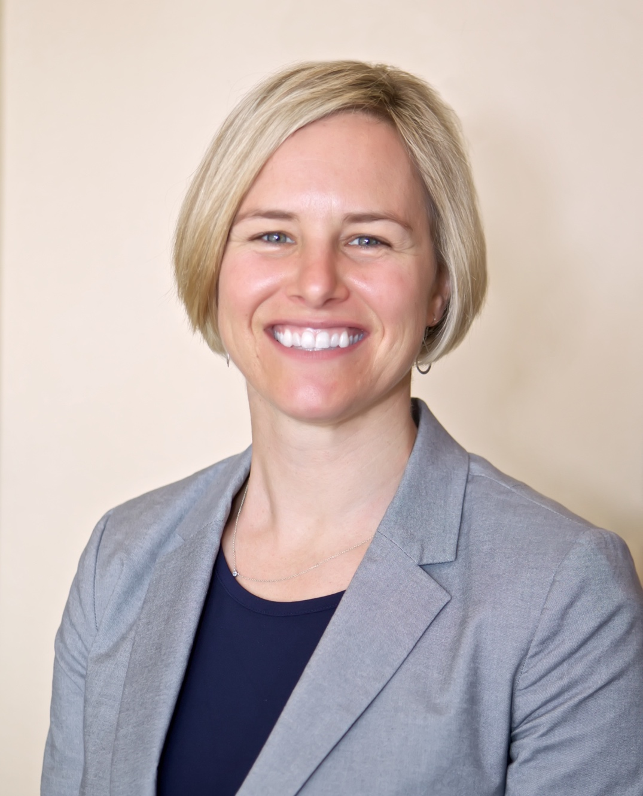
Explore your own thinking about resilience
“Resilience is defined in many different ways. To us here in Baltimore City, resilience is the ability of the community to anticipate, accommodate and positively adapt to or thrive amid changing climate conditions or hazard events and enhance quality of life, reliable systems, economic vitality and conservation of resources for present and future generations. In defining it this way, the city is committed to improving essential infrastructure and buildings, addressing histories of injustice, giving people more of a voice, protecting people and property, and preserving and restoring natural systems.
- Kristin Baja, City of Baltimore

Slide 6
Explore your own thinking about resilience
The 5W’s of resilience:
For Whom, What, Where, When & Why are you building greater resilience?
Are you thinking about resilience as a system property, a process, or an outcome?

Slide 7
Acknowledge differences & complementarities
What are the subtle and not so subtle differences in your and your partners’ vision of a resilient future?
Work to foster conversation that brings to the surface legitimate differences in perspective.

Slide 8
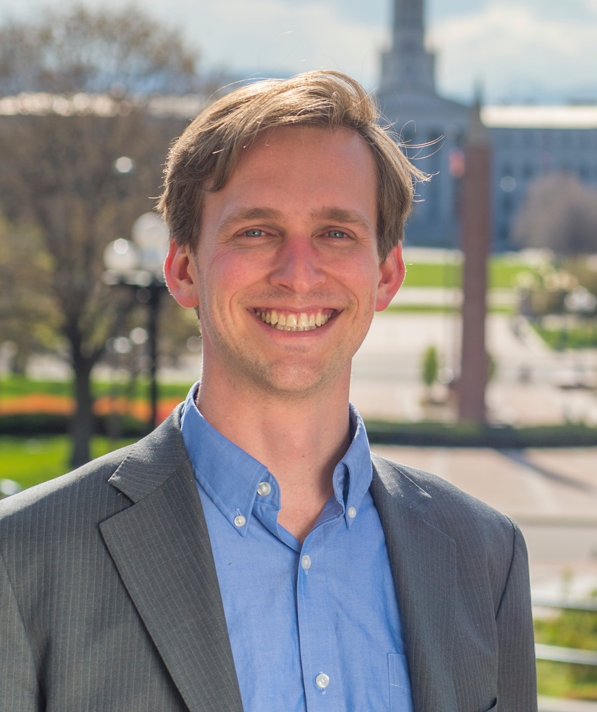
Find shared values and goals
“The State of Colorado is committed to building resilience, and it takes everyone—government, non-profits, the private sector, individuals—to get there. Building a culture of resilience requires a lot of conversation, coordination and trust. To get there we can unite around what matters to us—safe and thriving communities, our high quality of life, water, our natural environment, and the endless recreational opportunities that we enjoy. From these shared values, we can see how each of us has a crucial contribution to make.”
- Ian Hyde, State of Colorado

Slide 9
Find shared values and goals
Move towards a consensus on core principles and common goals.
This could result in diverse foci for action, e.g.:
- improving adaptability to a changing economy and environment
- improving social justice, or
- collective learning and action.

Slide 10
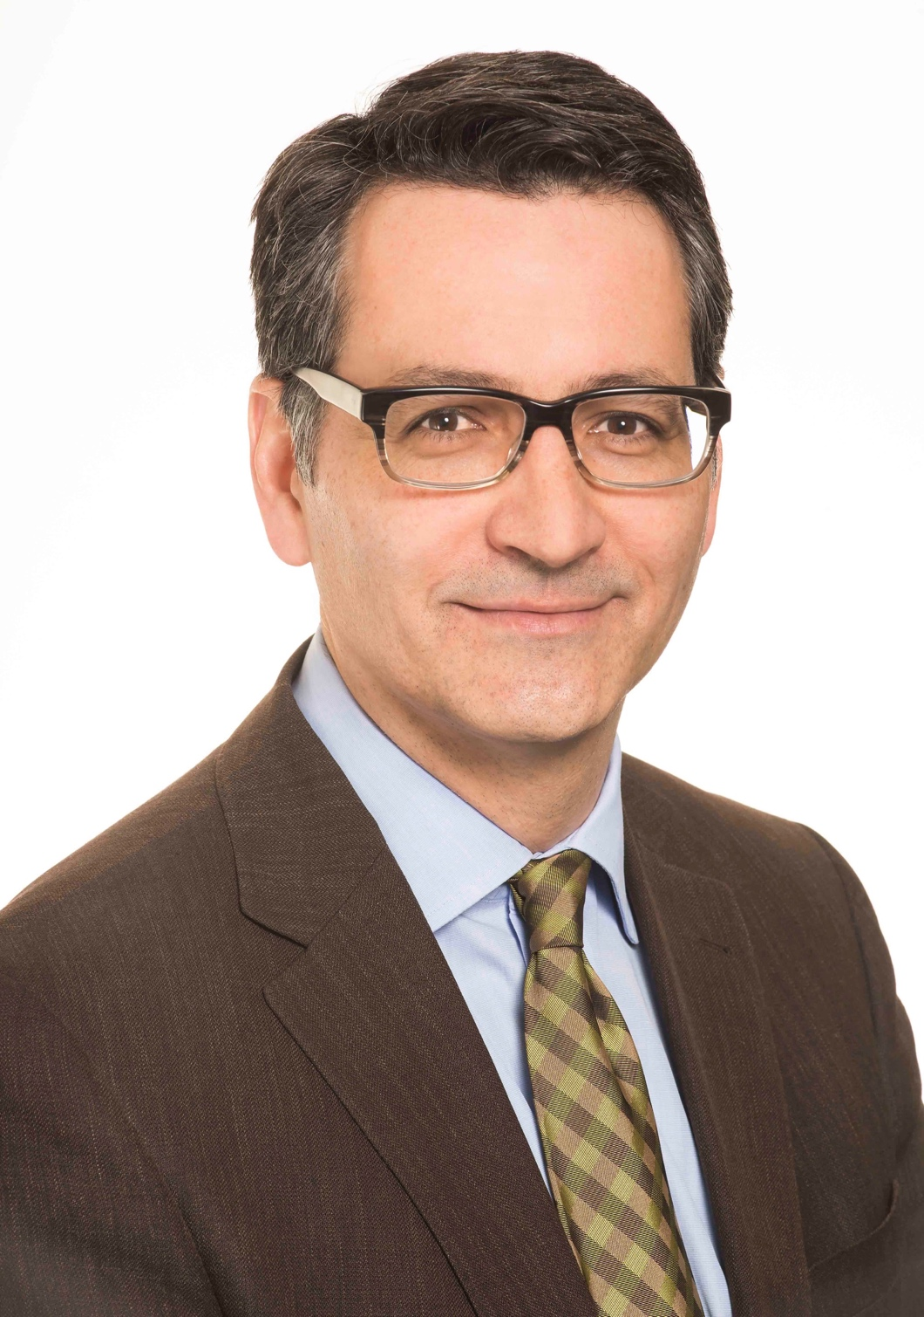
Build long-term partnerships & continue the dialogue
“Helping low-income communities become more resilient is one of our most fundamental imperatives as a society that is beginning to confront the realities of a changing climate. What we do to help those most vulnerable reflects who we are. We provide practical support, like basic capacity, training, tools and resources, while also helping to develop healthy and sustainable housing that is affordable. Based on that foundation, we can further help communities to thrive by ensuring access to quality food, transportation for employment and recreation, and investing in quality community assets like schools and health care facilities.”
-Tom Osdoba, Enterprise Community Partners

Slide 11
Build long-term partnerships & continue the dialogue
Dealing effectively with climate change and related disruptions is not conducive to easy one-off solutions.
Seek diverse partnerships and create opportunities for meaningful engagement.
Long-term ongoing learning processes is essential to remain alert to constantly changing conditions.

Slide 12
FOR MORE INFORMATION
WWW.AGCI.ORG/RESILIENCE
Produced by: With generous support from:

