Slide 1

FEMA Building Science Disaster Support
Overview | October 2022
Notes:
(Title Slide Option 1)

Slide 2
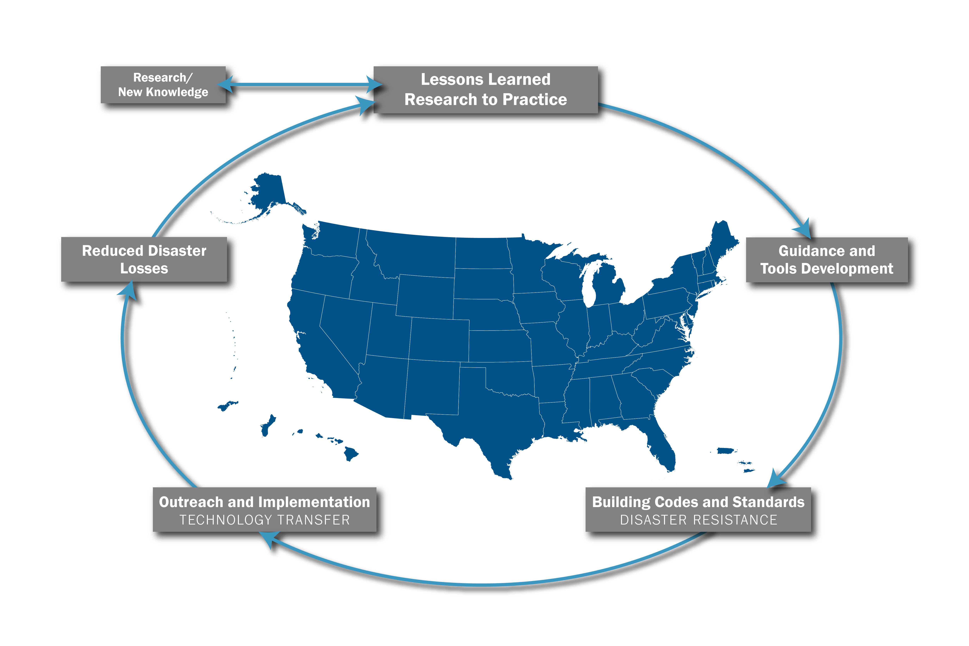
Building Science Disaster Support (BSDS) Program
FEMA uses the BSDS Program to evaluate the performance of buildings and related infrastructure in response to the effects of natural hazards. Building Science Disaster Support includes:
Disaster Readiness
Disaster Support Operations
Technical Assistance
These activities focus on the local impacted area, but lessons learned are carried forward to support nationwide resilience.
Notes:
We will go into greater detail about these activities on the following slides.

Slide 3
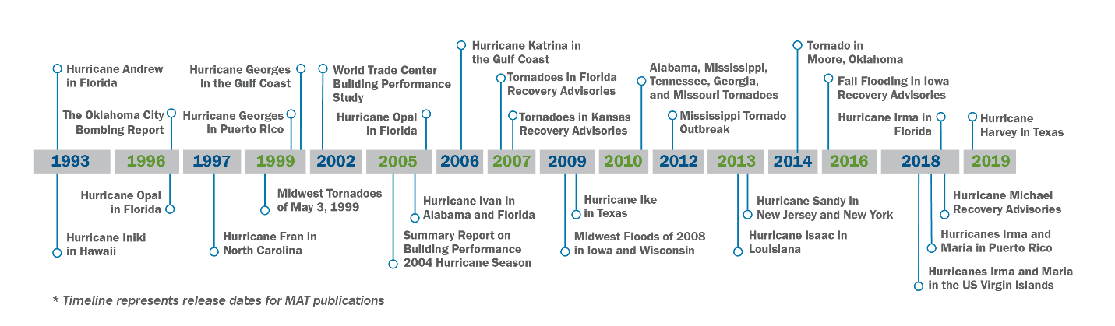
History
Notes:
30+years, component of the FEMA Building Science Branch
FEMA has deployed MATs to support significant disasters large and small
Application
Hazard mitigation publications and best practice documents
Recommendations for building codes and standard changes
Influence hazard mitigation programs
Supports FEMA’s mission, strategic plans, and National Disaster Recovery Framework (NDRF)

Slide 4






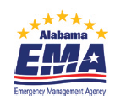















Stakeholders
BSDS Program Activities include a large selection of stakeholders including but not limited to:.
Federal and SLTT officials, academia, private sector,
+ many more…
Notes:
In addition to the team stakeholders shown here, the MAT serves the impacted community, from state and local officials, to individuals interested in building science best practices.

Slide 5
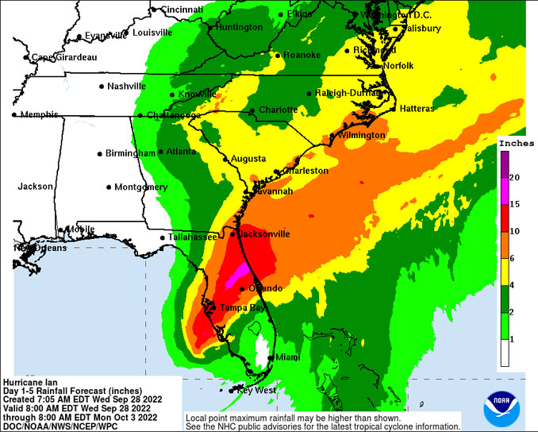
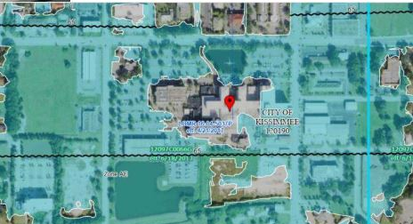
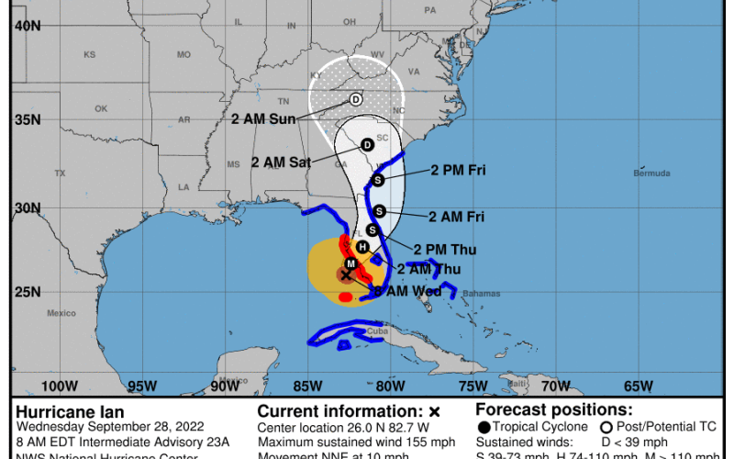
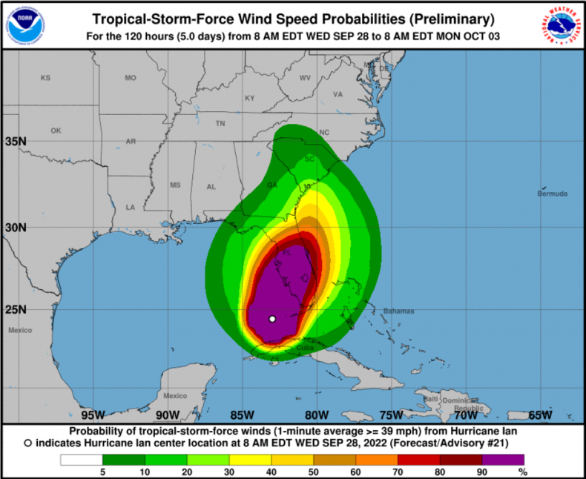
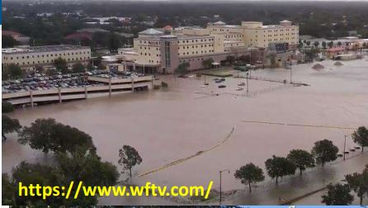
Building Science Disaster Support Activities
Disaster Readiness
  Monitoring forecasted and ongoing events to determine impacts
  May Deploy Pre-MATs to make preliminary damage assessments
Notes:
When major natural disasters are forecasted, FMEA Building Science begins collecting data about the hazard and impacts of the disaster. Data about wind speed, rainfall, surge, As the disaster occurs, Building Science staff collect data about the impacts to the local infrastructure: damage to critical infrastructure (hospitals, shelters, schools, police/fire/EMA, etc.), residential structures and non-residential structures. The data are evaluated by FEMA to determine if the infrastructure performed to design and if there are potential lessons learned that could benefit national resilience.

Slide 6
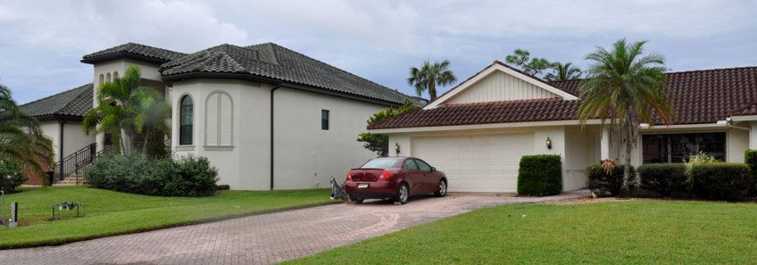
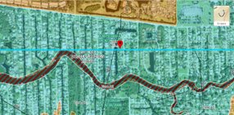
Hurricane Ian Pre-MAT
Bonita Springs – flood impacts
FEMA MAT - Internal Use Only
Notes:
27226 Barefoot Ln, Bonita Springs, FL 34135 Zone AE “Imperial River”​
2016 on the left vs 1994 on the right
After Hurricane Ian, the Building Science Disaster Support Program (BSDS) conducted preliminary Mitigation Assessment Team (Pre-MAT) field work from Oct. 12th to Oct. 14th.
3 teams were deployed to the affected are in Florida
Team 1 – Coastal – focused on the barrier islands and frontal surge areas
Team 2 – Inland flood & wind – focused north of Ft. Myers
Team 3 -Inland flood & wind – focused south of Ft. Myers
Midday on day 2, followed the track of Ian across to the east coast.

Slide 7
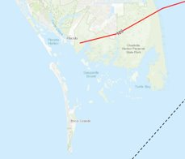
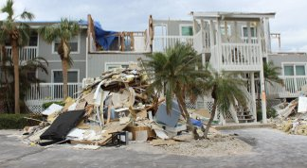
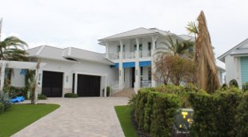
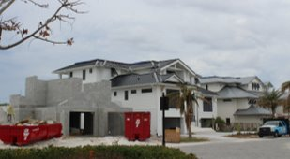
Hurricane Ian Pre-MAT
Boca Grande – Representative Wind Damage
1980’s Condos
2019
New
FEMA MAT - Internal Use Only
Notes:
Left photo – 1980's condos with significant structural damage on boca grande causeway​
​
Right two photos – new construction on the southern tip of Boca Grande. Single ply failure on flat roof portion of home on the right. Impact slider failed on home on the right likely due to installation issues.​
​
Estimated wind speed is 120 mph

Slide 8
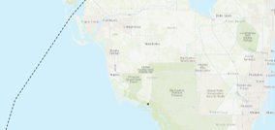
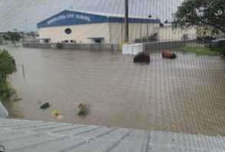
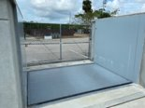
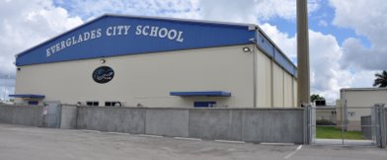
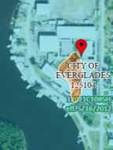
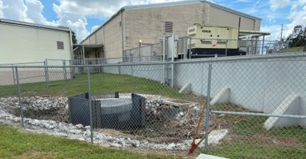
Hurricane Ian Pre-MAT
Specific Locations – Everglades City School
Source - Twitter @FloodGeek101 (Marco Island FPA)​
FEMA MAT - Internal Use Only
Notes:
https://pbs.twimg.com/media/FeUo6PaXgAAczXK?format=jpg&name=small​
Everglades City School - 415 E School Dr, Ochopee, FL 34141 (Zone AE)​
PA 406 HM after Hurricane Irma​
Andrew - DFE based on ASCE 24, entire campus surrounded by floodwall (gymnasium lowest point on west side, modular classrooms in center as well​
Interior drainage/sump, pump on emergency power, check valve on all utilities, passive barriers ​
Brandon – manually deployed barriers before event​
School up and running Monday after event, Asst Principal could not have been happier with project

Slide 9
Hurricane Ian Pre-MAT
Preliminary Observations
      Surge flooding moved inland up the rivers a significate distance (while FMB has several destroyed buildings, thousands of homes in Lee, Collier, and parts of Charlotte Counties had water in them; many of which may not meet SD threshold).
      Development density in the surge zones resulted in significant amounts of damage.
      Wind speeds below design levels
      Unexpected wind damage to some critical facilities (health care facilities)
      Numerous "OPERATIONAL" failures to critical facilities due to loss of infrastructures combined with inadequate backup systems.
      Post Charley construction, built to later codes & standard preformed markedly better, as expected. We observed many side by side examples.
      Elevation & Freeboard preformed markedly better, as expected. We observed many side by side examples.
      Building performance is improving (per two previous bullets); BUT we probably need to rethink siting and risk tolerance
      Observed poor shelter performance. Including a FEMA 404 and/or 406 funded facility in Arcadia.
FEMA MAT - Internal Use Only

Slide 10
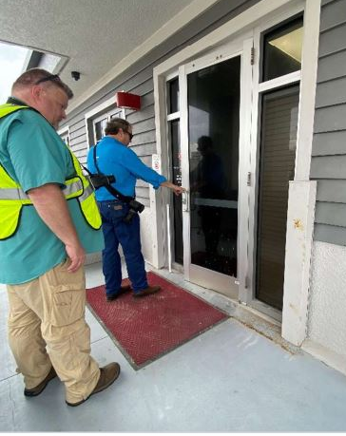
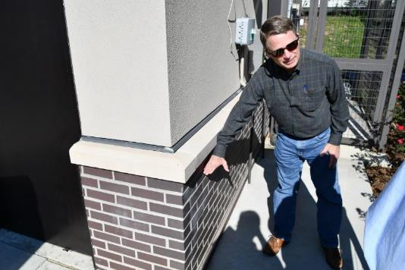
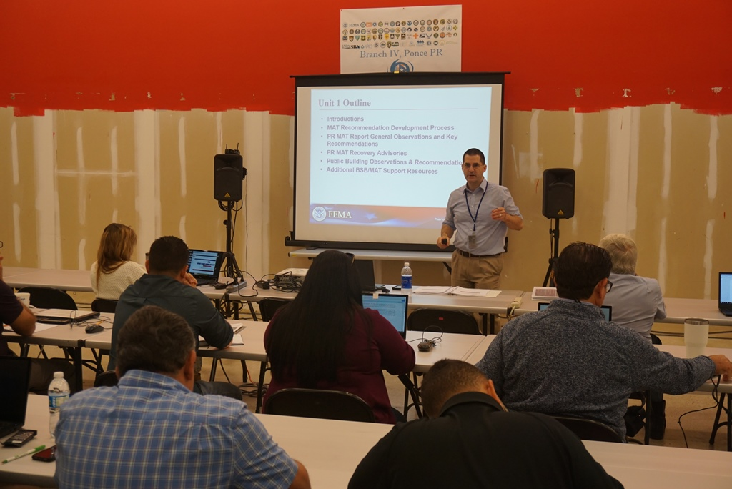
Building Science Disaster Support Activities
Disaster Support Operations
  Work may include Mitigation Assessment Team (MAT) field work to conduct building performance assessments, determine causes of structural failure, study successes – what worked!
  Development of MAT Reports, Problem-Focused Study Reports, Recovery Advisories, or Fact Sheets to promote best practices and resilience through rebuilding.

Slide 11
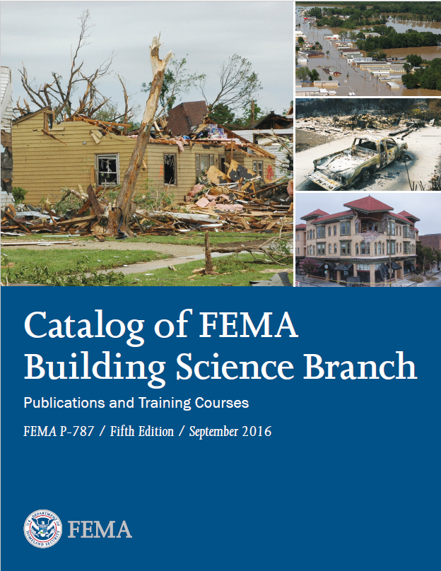
Building Science Disaster Support Activities
Technical Assistance and Deliverables
  Include training, presentations/webinars
  SME support
  Support of mitigation strategy development
  Can also include assistance to SLTTs for promotion of the application, adoption, and enforcement of building codes through the disaster recovery efforts

Slide 12
Impacts of BSDS Support
BSDS Program Support has benefitted national resilience in many ways.
  Forensic engineering studies of building performance help us learn what works and what doesn’t work
  With this knowledge, recommendations are made to improve the building science state of practice through better design and construction techniques and standards
  Recommendations resulting from BSDS work are being implemented in FEMA Policy, grant requirements, codes and standards changes, codes adoption, development of higher standards and more…

Slide 13
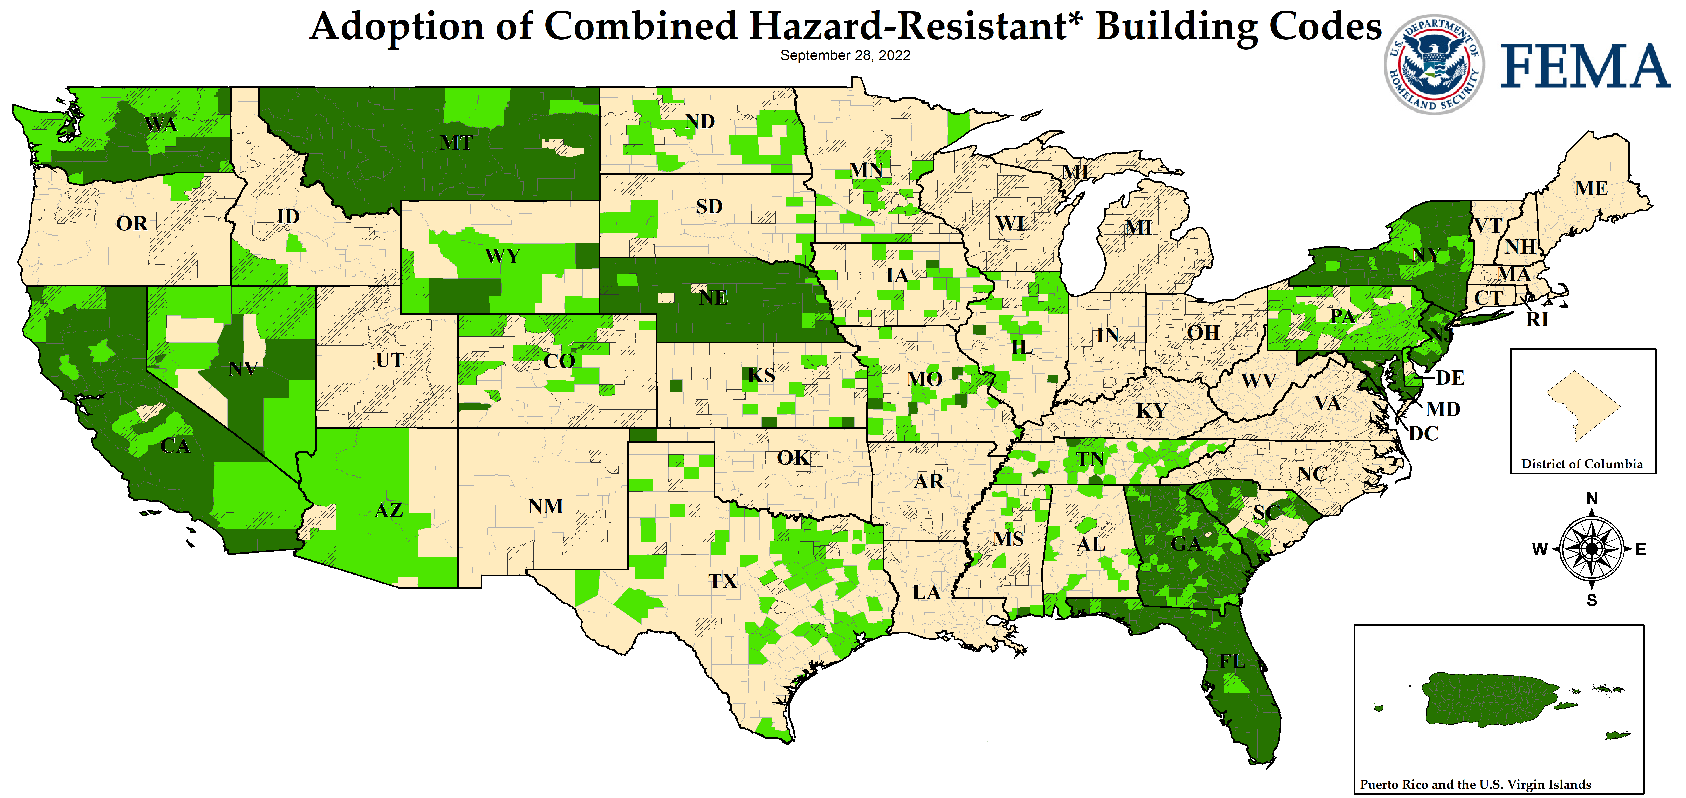
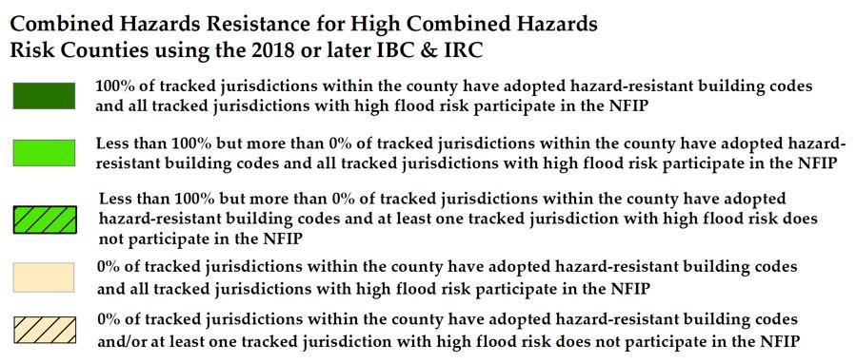
Nationwide Adoption of Building Codes Promoting Hazard Resistance

Slide 14
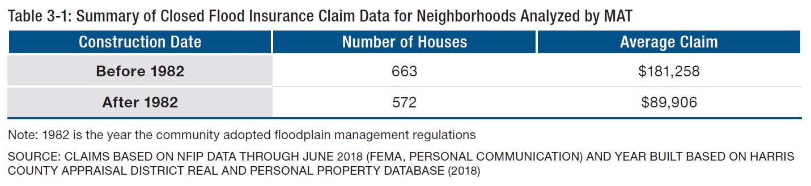
Higher Standards Matter
National Institute of Building Science’s Natural Hazard Mitigation Saves: 2019 Report estimates that compared with past (1990s-era codes), modern codes improve building resilience to natural disasters and save $11 for every $1 invested. (NIBS, 2019).
Building codes promoting hazard resistant infrastructure are projected to prevent $132 billion in losses over 30 years
FEMA P-2022, Mitigation Assessment Team Report: Hurricane Harvey in Texas revealed that higher building code standards saved almost $100,000 on insurance claims on average
Notes:
Top Table 3-1
Neighborhood A pre and post FIRM claim similar to the claims across ALL neighborhoods

Slide 15

What Questions do You Have?

Slide 16
Contact Us
https://www.fema.gov/building-science
Building Science Helpline:
FEMA-BuildingScienceHelp@fema.dhs.gov
(866) 927-2104

Slide 17
Thank you.

